Slide 1
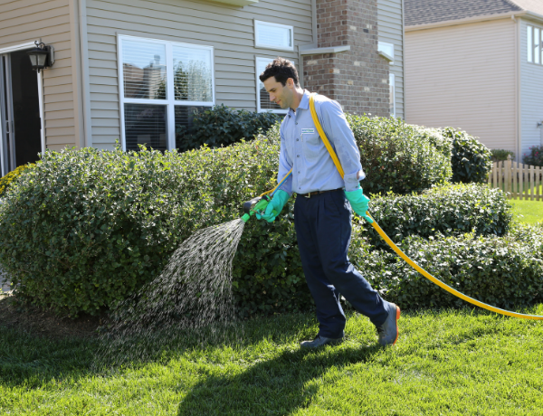
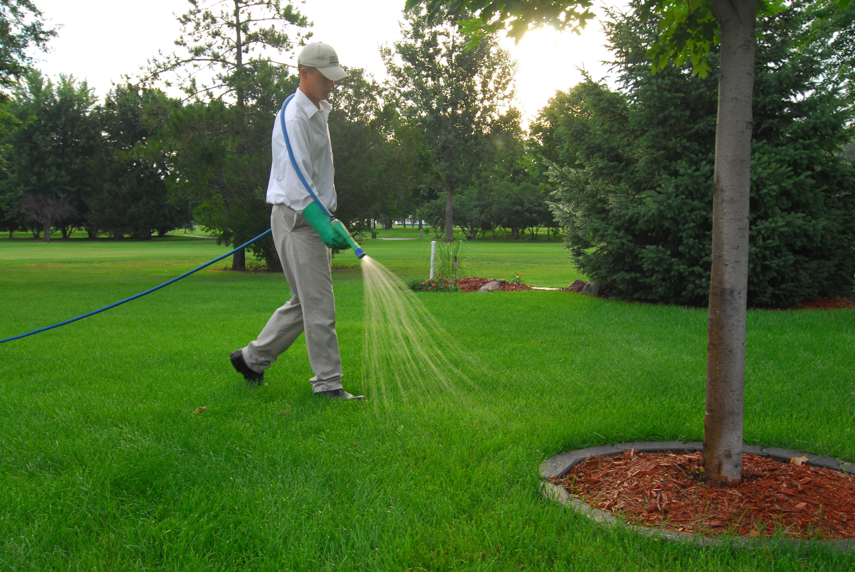
Sensitivity Analysis and Model Evaluation of Bifenthrin Surface Water Concentrations from California Urban Runoff
Emma Chelsvigª, Frederick Ayiviª, Yuzhou Luo^{b}, Debra Denton^{c}, Ann Pitchford^{d}, Sandy Raimondo^{e}, Donald Ebert^{e}, S. Thomas Purucker^{e}, Yongping Yuan^{e}
ªOak Ridge Institute of Science and Engineering (Chelsvig.Emma@epa.gov, frederickayivi@gmail.com)
^{b}California Department of Pesticide Regulation (Yuzhou.Luo@cdpr.ca.gov)
^{c}U.S. Environmental Protection Agency Region 9 (Denton.Debra@epa.gov)
^{d}Retiree, previously U.S. Environmental Protection Agency, Office of Research and Development (pitchford3@cox.net)
^{e}U.S. Environmental Protection Agency, Office of Research and Development (Raimondo.Sandy@epa.gov, Ebert.Donald@epa.gov, Purucker.Tom@epa.gov, Yuan.Yongping@epa.gov)

Slide 2
Goals
Employ deterministic and probabilistic approaches with PWC to simulate bifenthrin concentration in runoff
Identify sensitive inputs with respect to model output variability

Slide 3

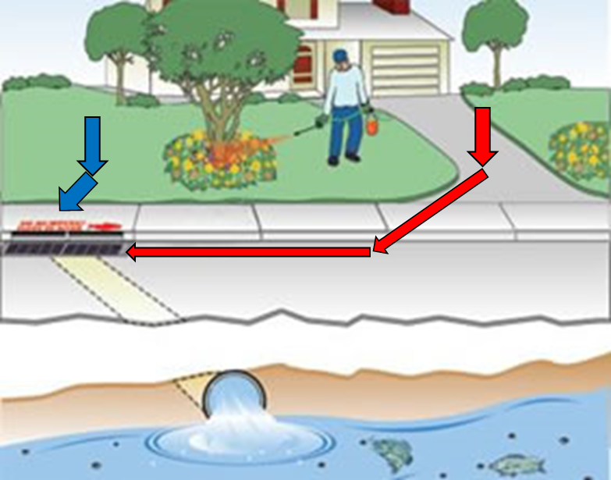
Study Overview
Sacramento-San Joaquin River Delta
Habitat for fish and invertebrate species
Experiencing habitat loss due to pyrethroid use and its associated pollution
Bifenthrin
Pyrethroid; toxic to Delta species
Used by professional pest control applicators for landscape application or as perimeter treatments to structures
Considerable amount in urban runoff after rain events
Use exposure models (ex., PWC)
Rain

Slide 4
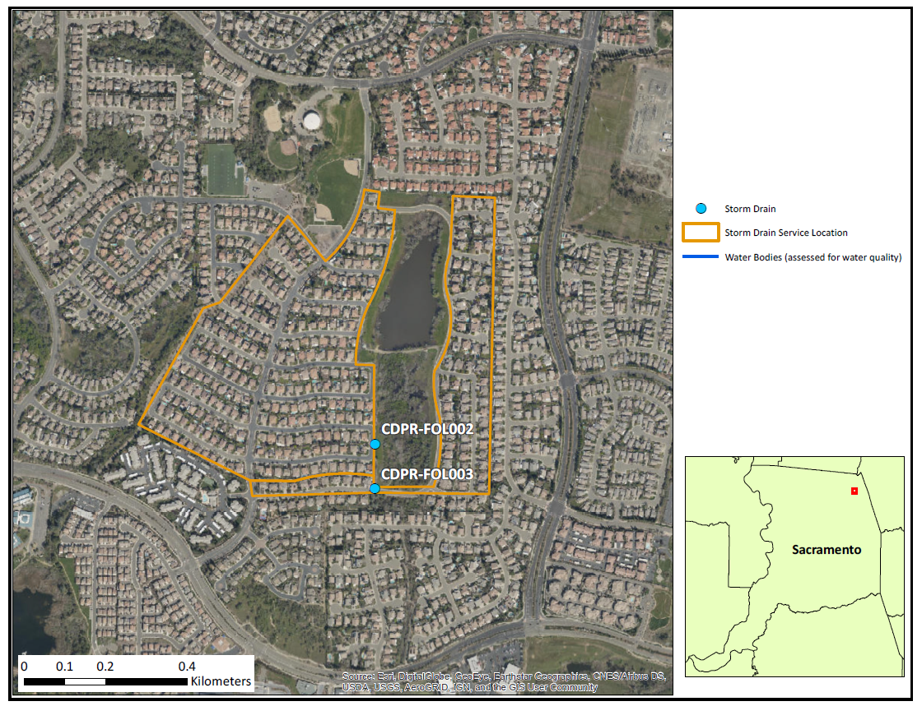
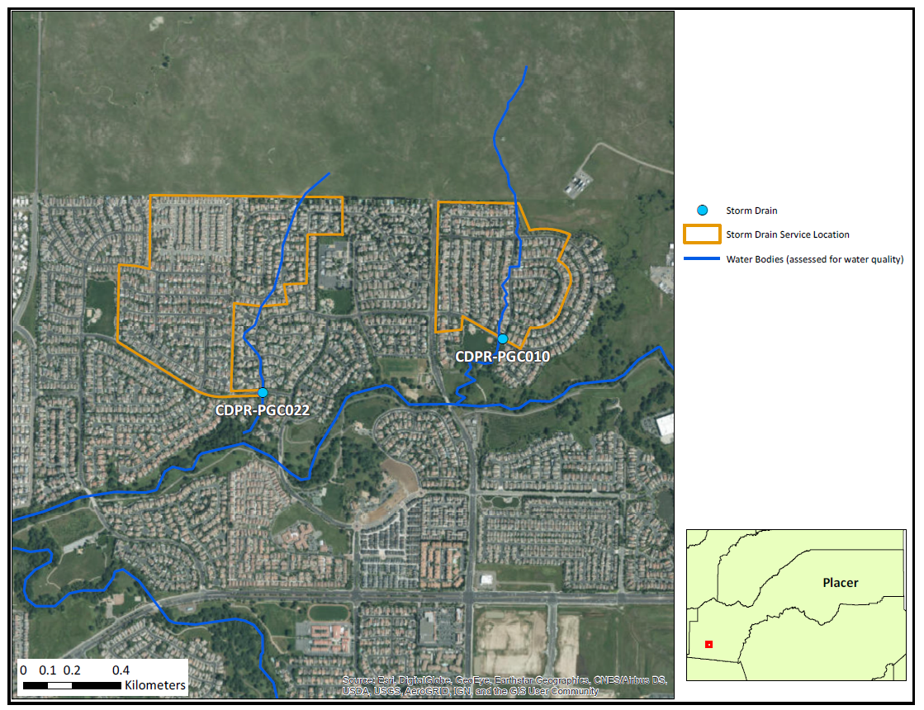
Site Overview
Storm Drain Locations in Folsom, Sacramento County
Storm Drain Locations in Roseville, Placer County

Slide 5
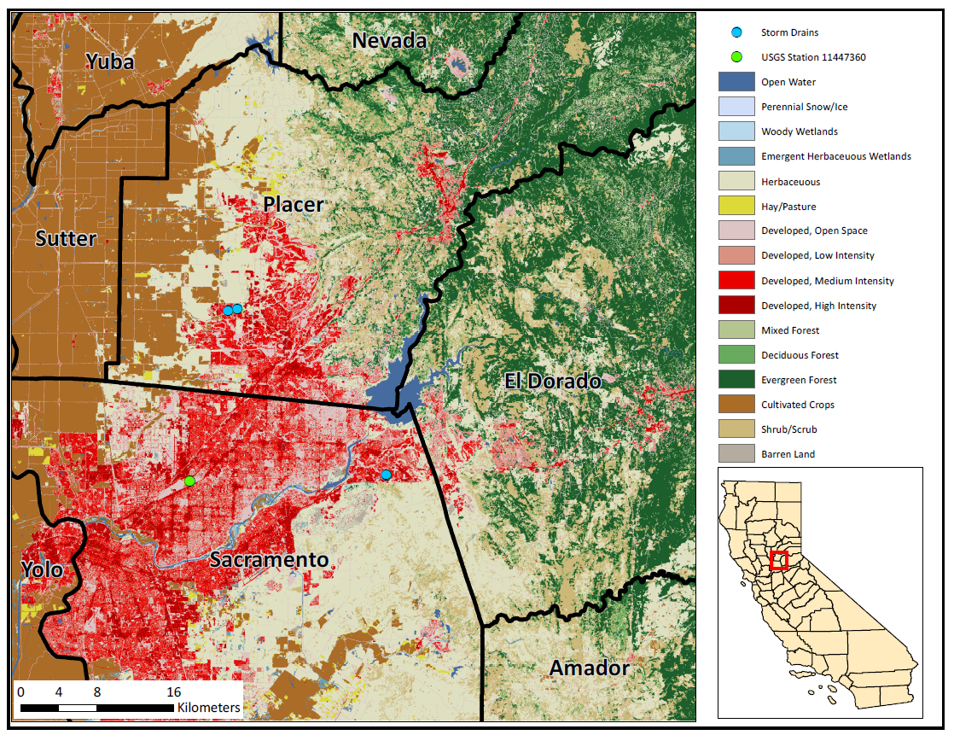

Slide 6
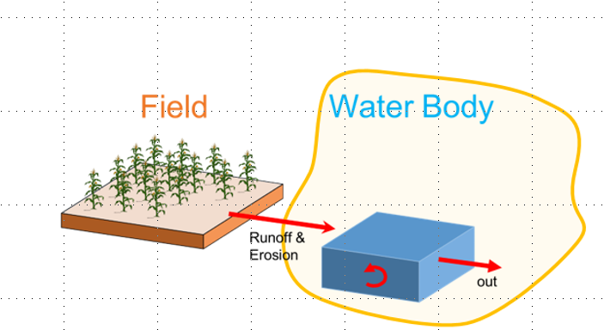
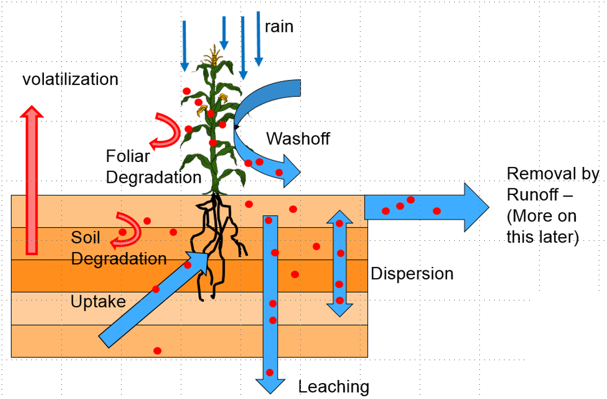
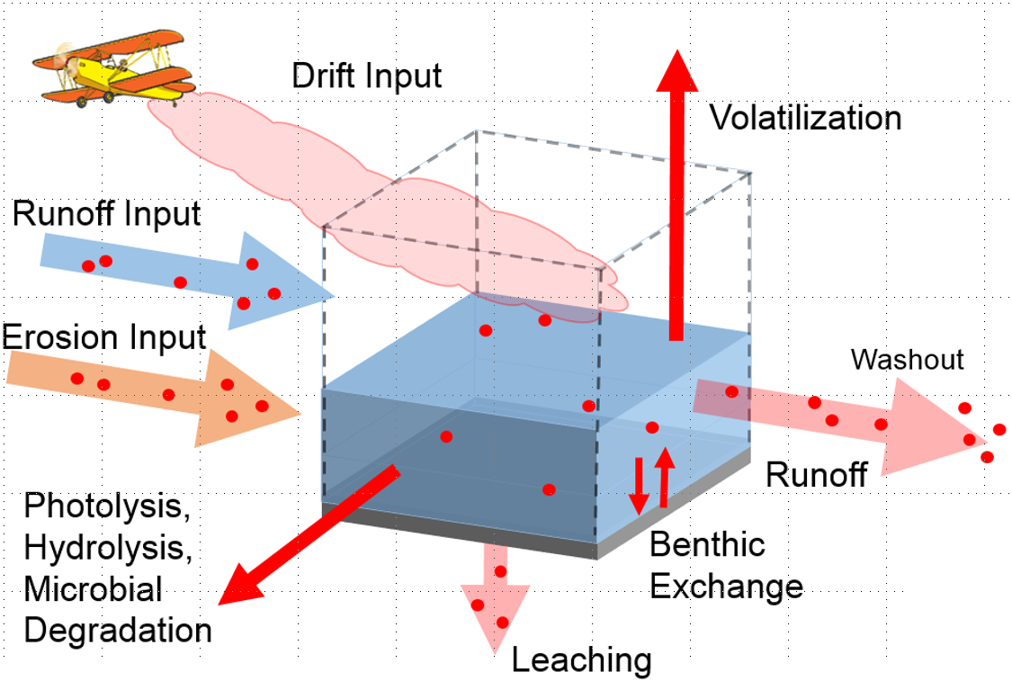
PWC
US EPA Office of Pesticide Program
Simulates pesticide concentration in surface water
Pesticide Root Zone Model (PRZM)
Variable Volume Water Model (VVWM)
Site-specific inputs
PRZM
VVWM

Slide 7
Deterministic Model setup
Single value (conservative estimate) for all input parameters
*.wea weather file (Fry et al., 2016)
One weather station assigned to each storm drain site based on nearest distance between storm drain and grid centroid
2008 – 2014
PUR monthly application rates
2009 - 2014
Bifenthrin application sites included: landscape maintenance, structural pest control, regulatory pest control, rights-of-ways, public health pest control
Divided monthly urban applications (kg) by urban area in county (ha)
Homeowner use: Multiplied monthly app rates by 25%, and added this additional amount to monthly rates
Assumed the amount of pesticide used every day is constant (Gorgoglione et al., 2018)
Input daily application rates

Slide 8
Probabilistic Model setup
03_write_update_run_pwc.R
lhs_input_ranges.csv
PRZM5.exe
*.wea
06a_pcc_computation_daily.R
06b_pcc_computation_max.R
update
PRZM5.inp
copy
run PRZM
05_write_output_into_df.R
Compute PCC (daily and max)
02_lhs_parameterization.R
Create time array
Store outputs as time series (*.RData, *.csv))
Conduct Latin Hypercube sampling for each parameter
Create input data frame and store inputs (5000 values for each parameter)
*.zts
*.prn
04_write_update_vvwm.R
VVWM.exe
07a_pcc_graphics_daily.R
07a2_pcc_graphics_daily.R
07b_pcc_graphics_max.R
07c_percentile_graphics.R
update
copy
run VVWM
vvwmTransfer.txt
Create PCC graphics
Create percentiles plots
*.csv
*.txt

Slide 9
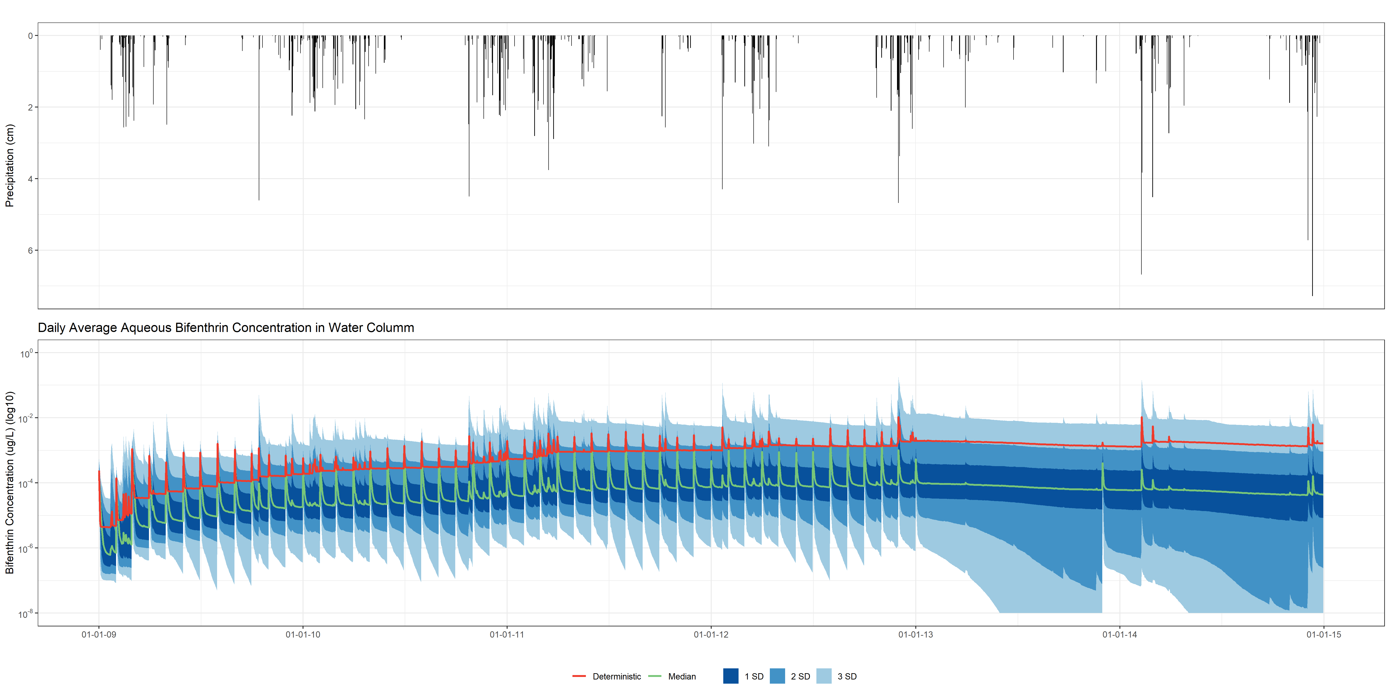
Results
FOL002

Slide 10
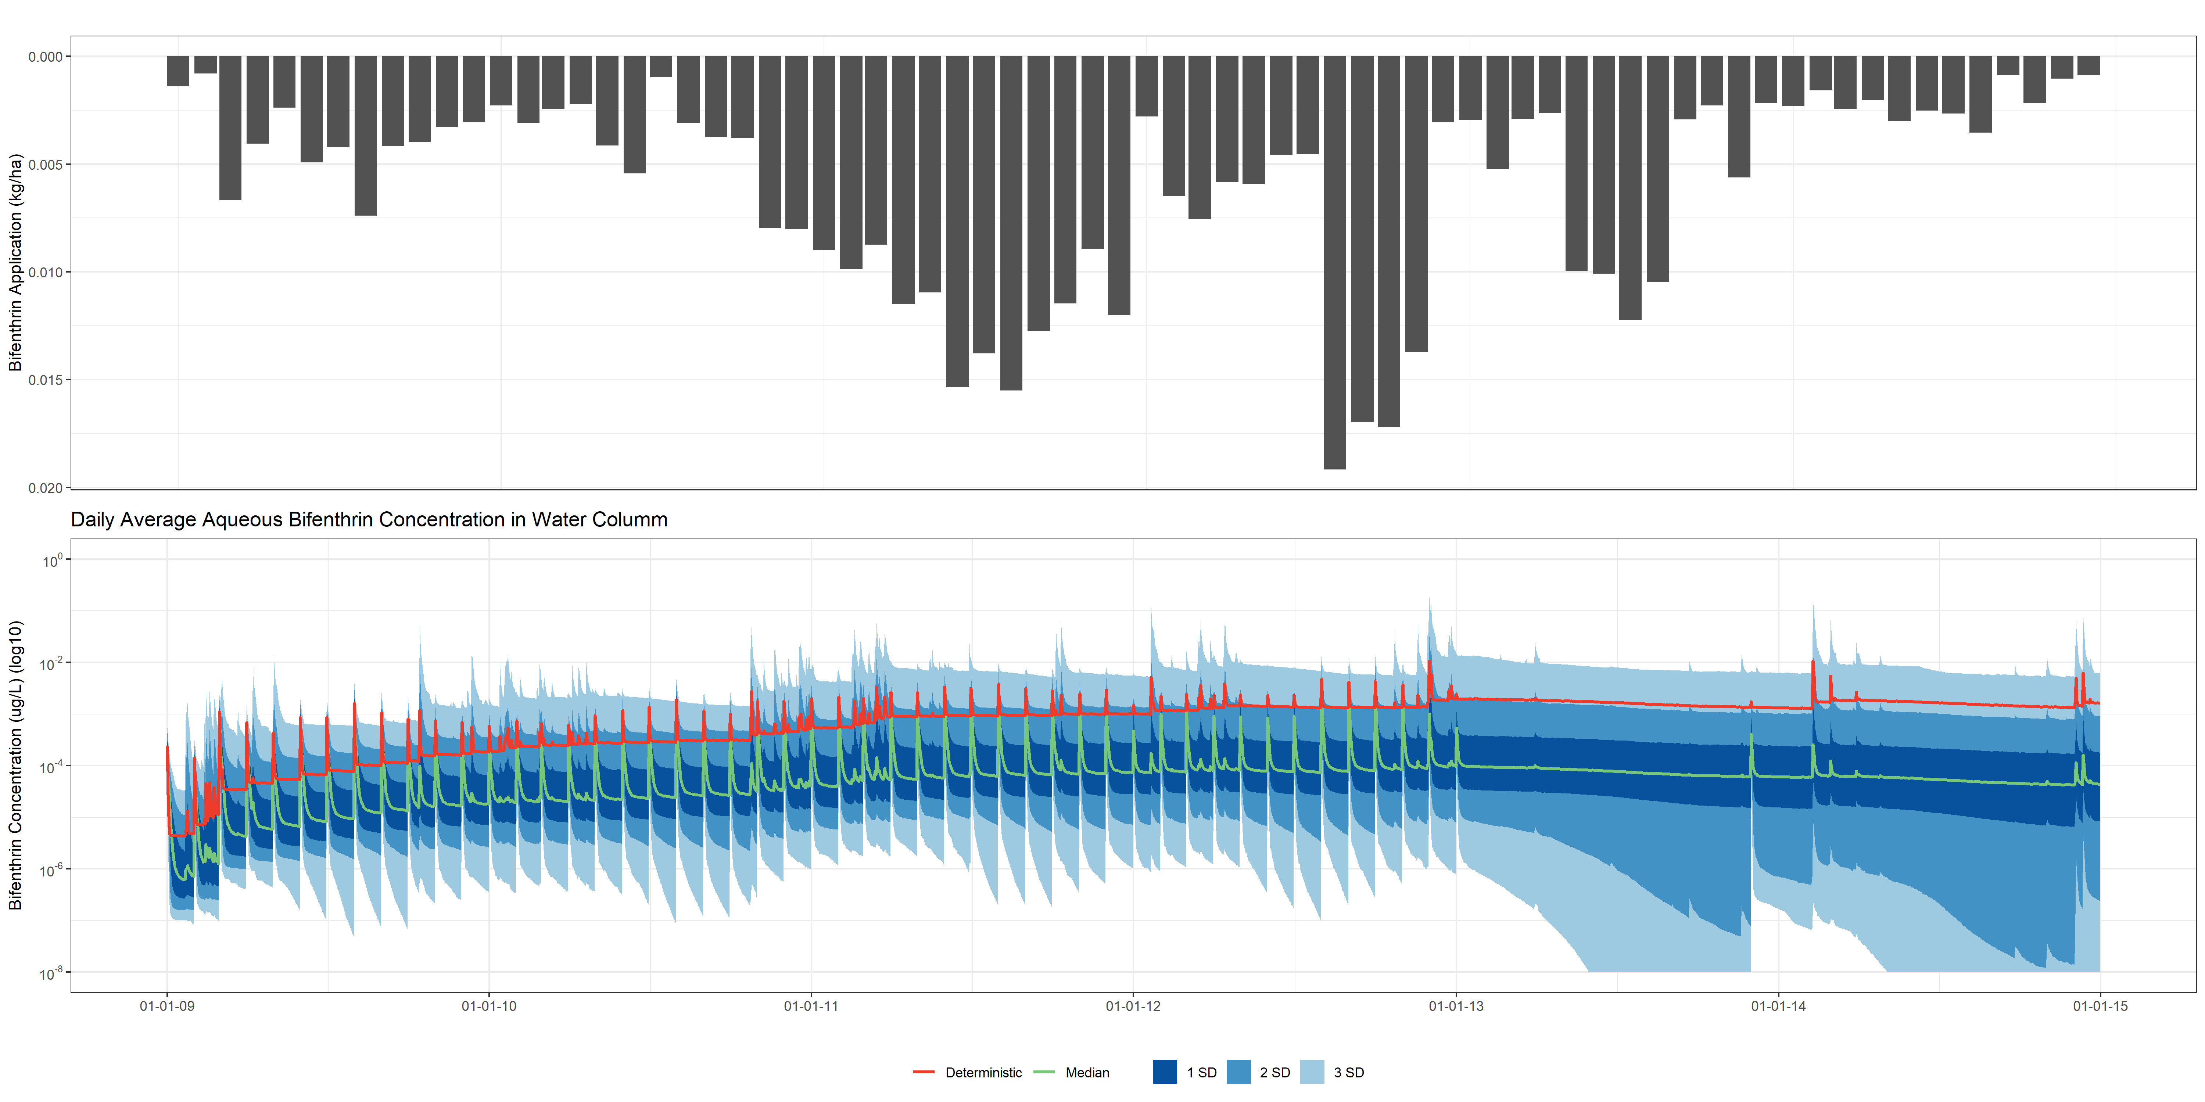
Results
FOL002

Slide 11
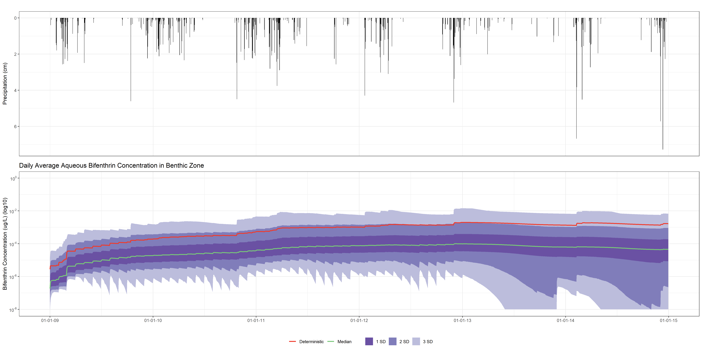
Results
FOL002

Slide 12
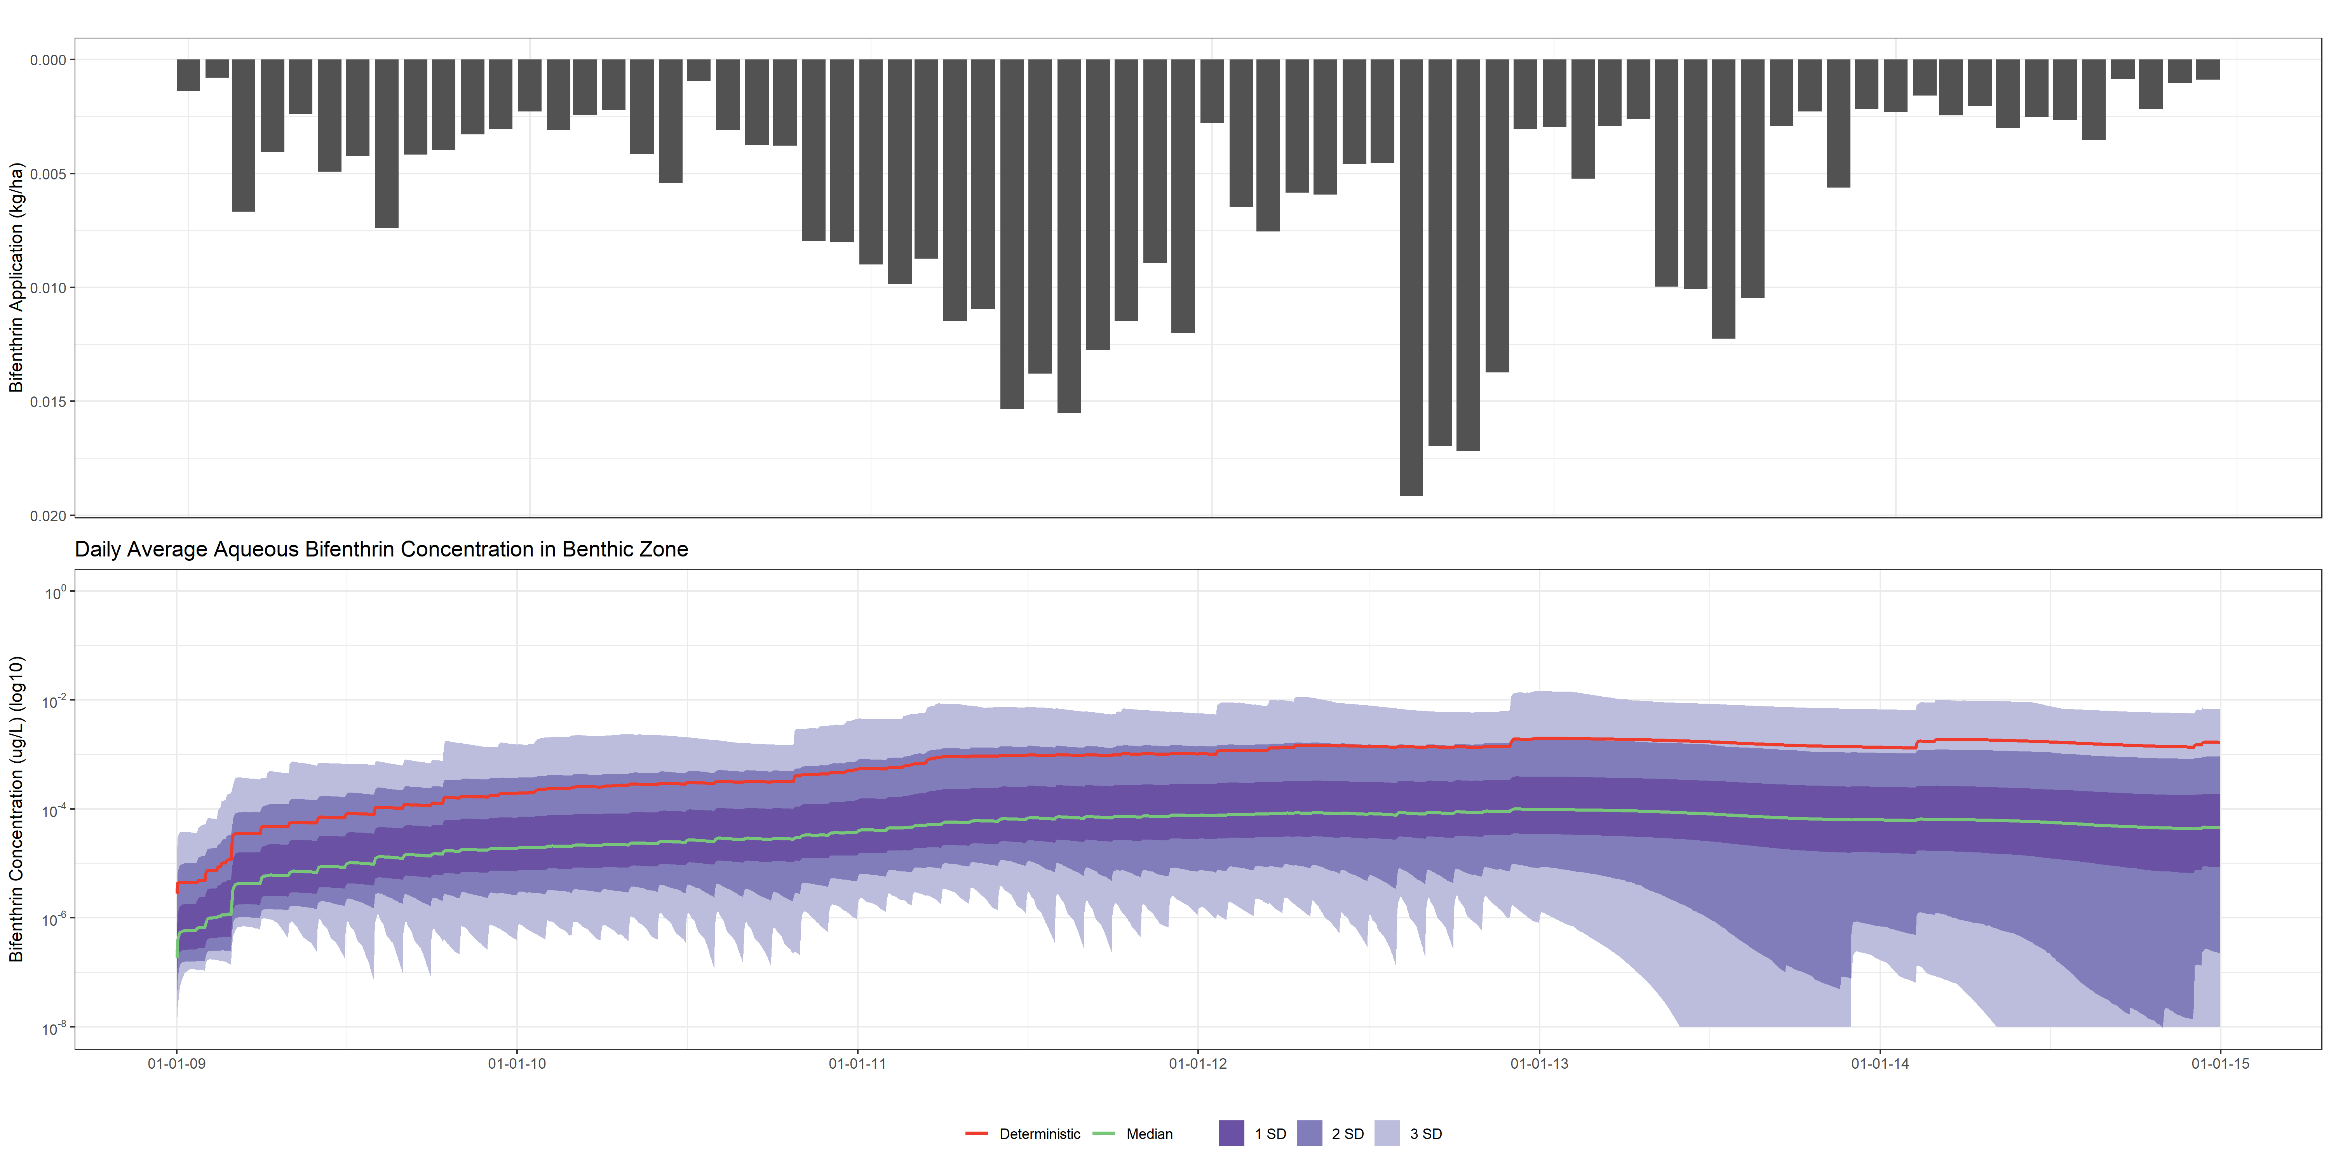
Results
FOL002

Slide 13
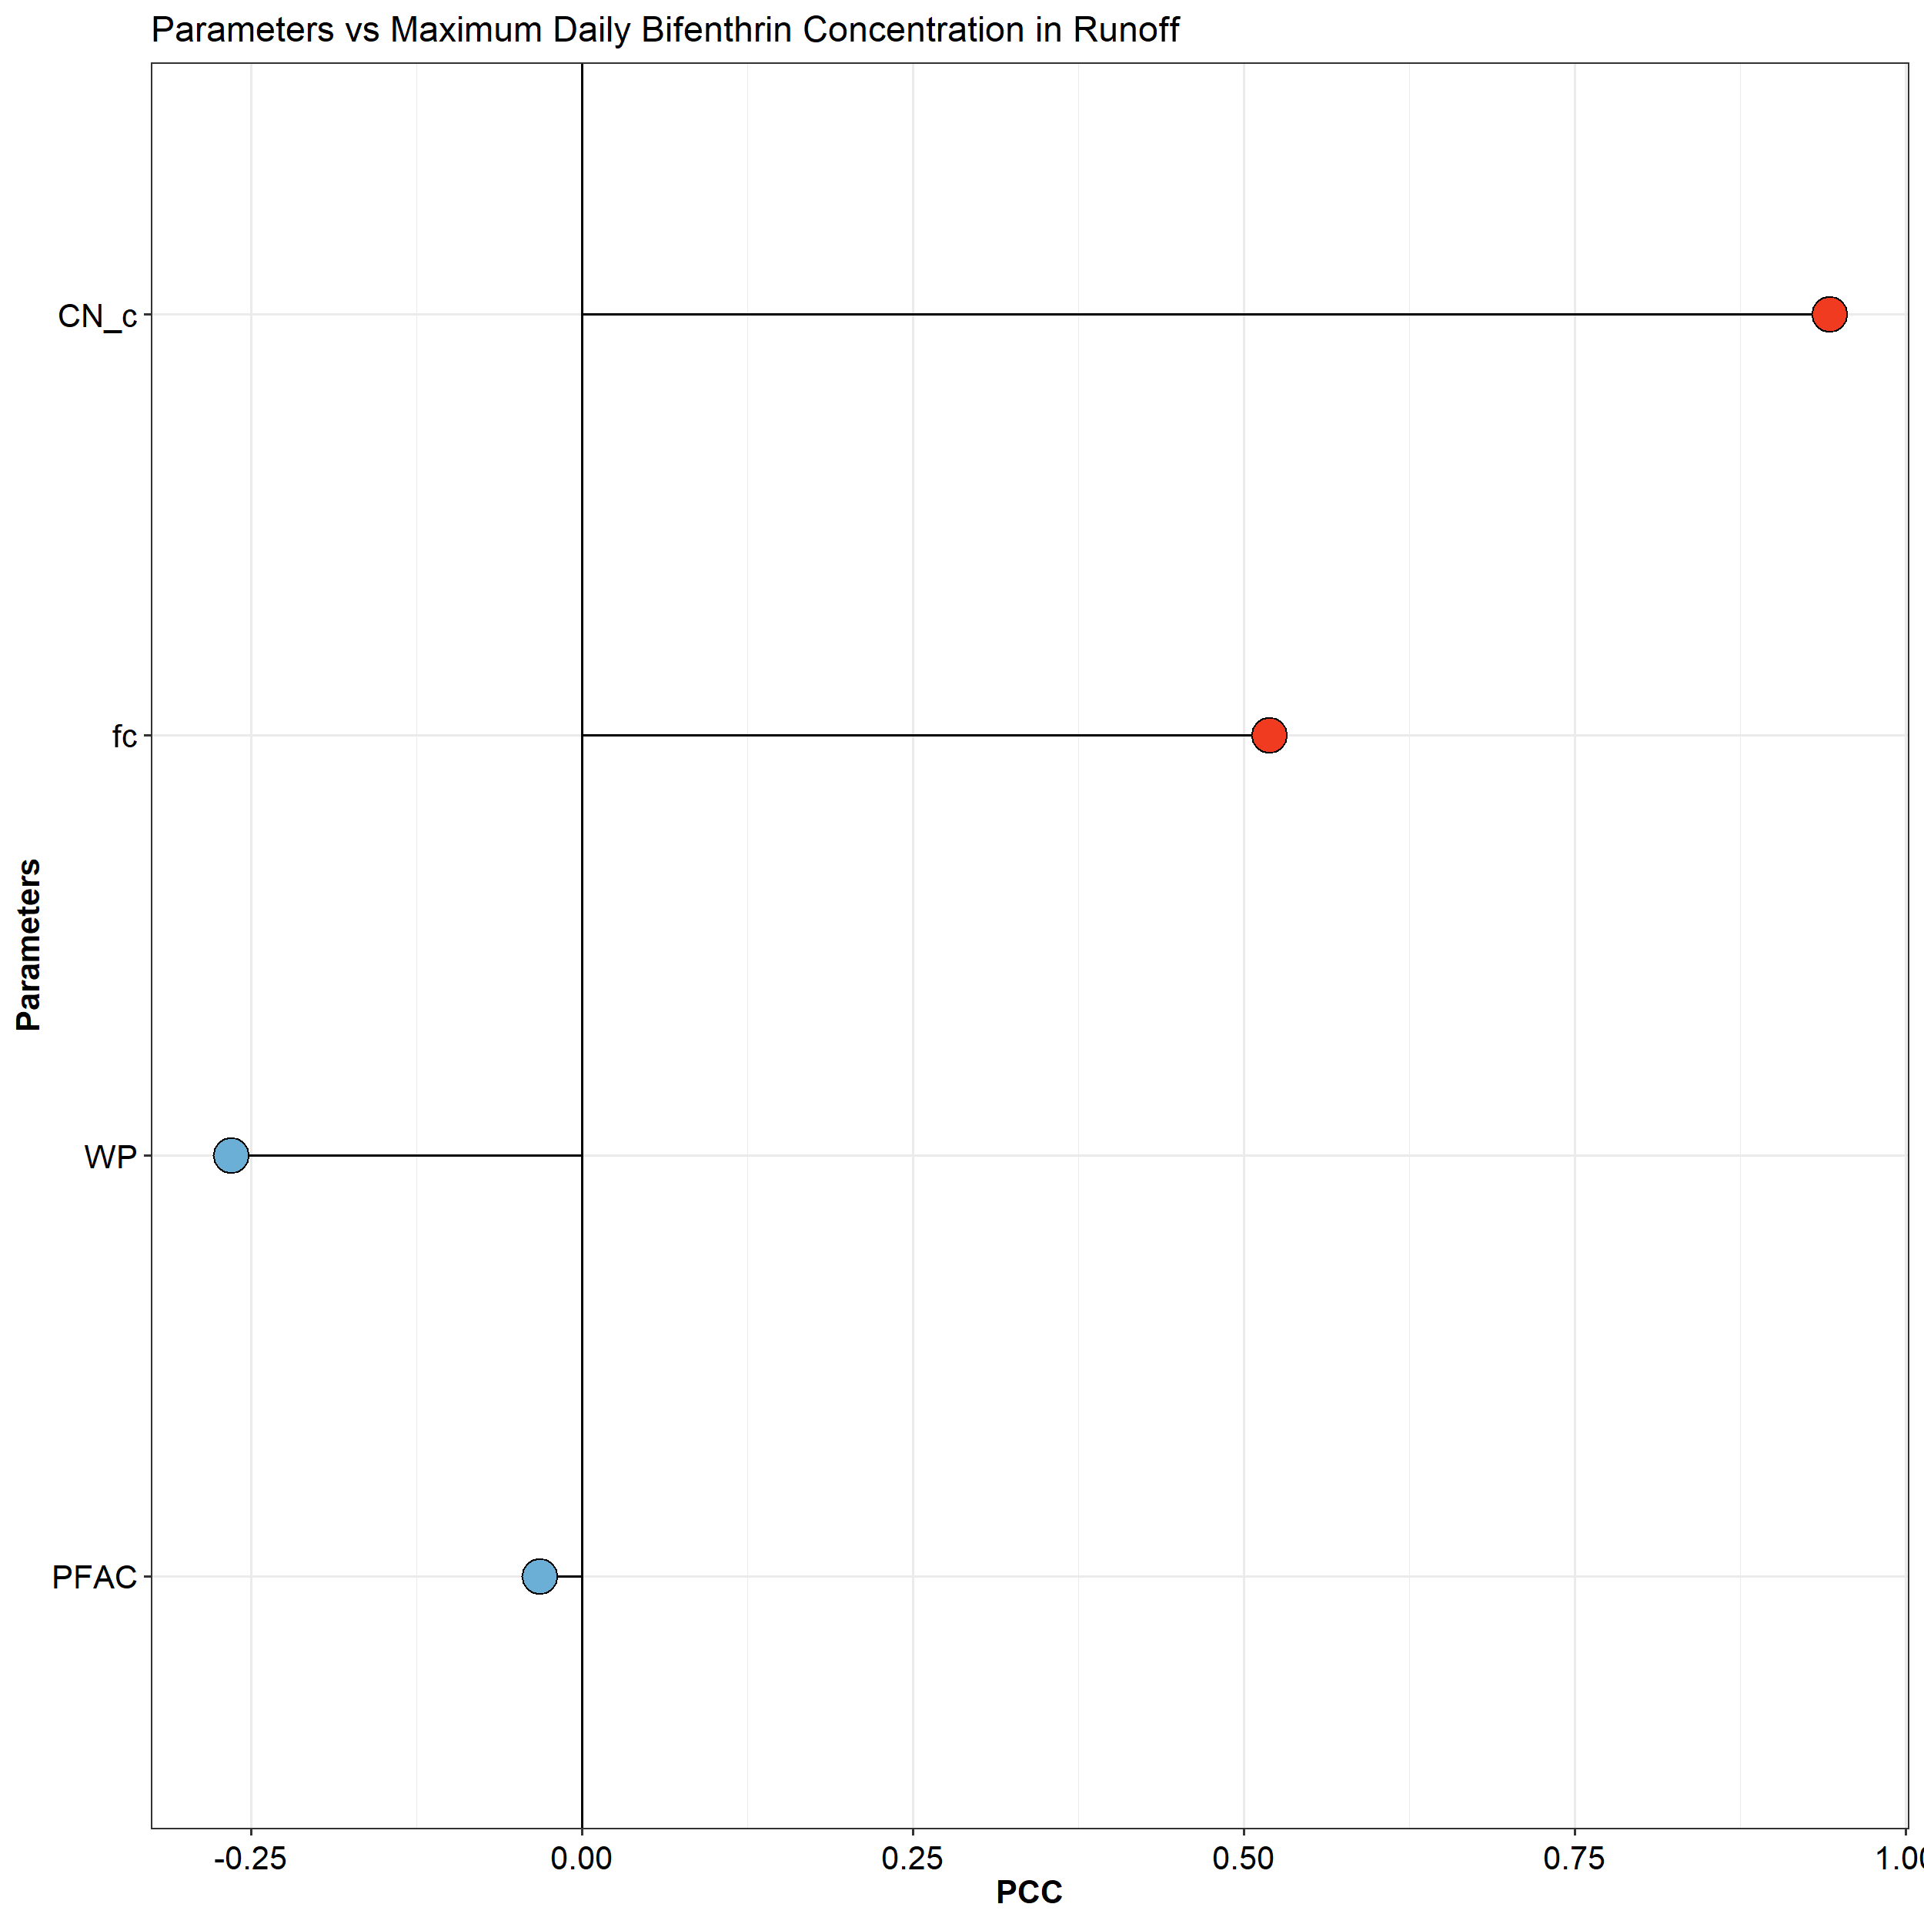
Results

Slide 14
Results
Sensitivity analysis results (PCC time series plots for sensitive parameters)

Slide 15
Summary
Summarize findings, etc.

Slide 16
The End

Slide 18
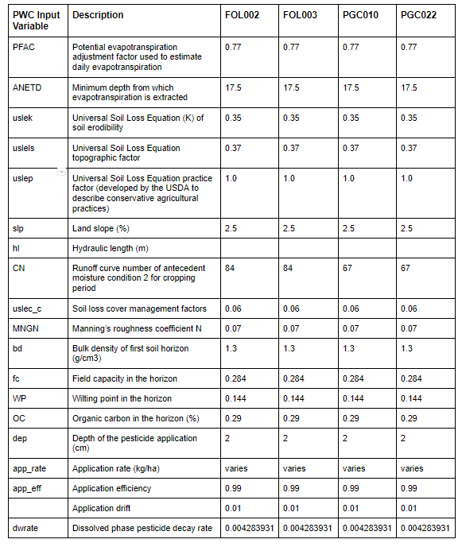
Deterministic Input Parameters

Slide 19
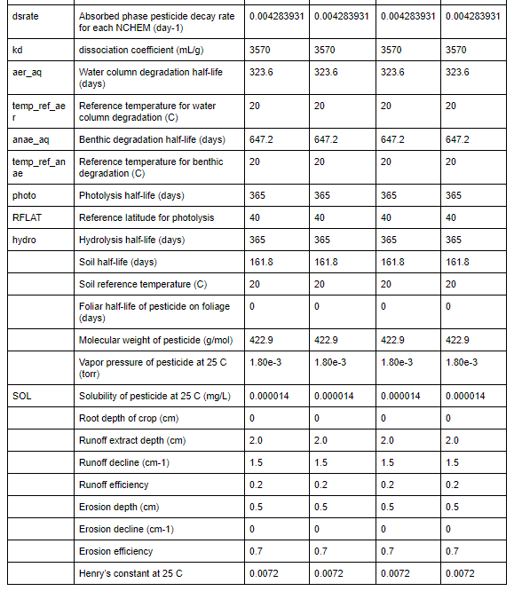
Deterministic Input Parameters

Slide 20
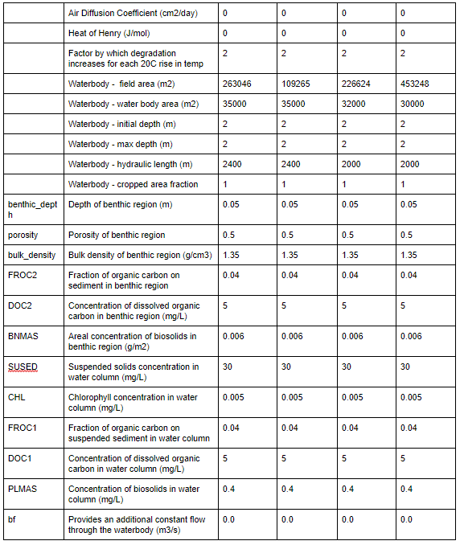
Deterministic Input Parameters

Slide 21
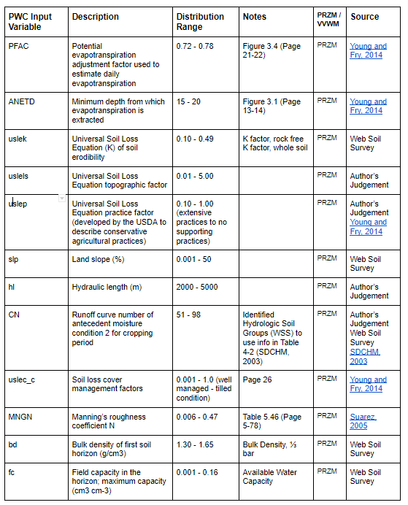
Probabilistic Input Ranges

Slide 22
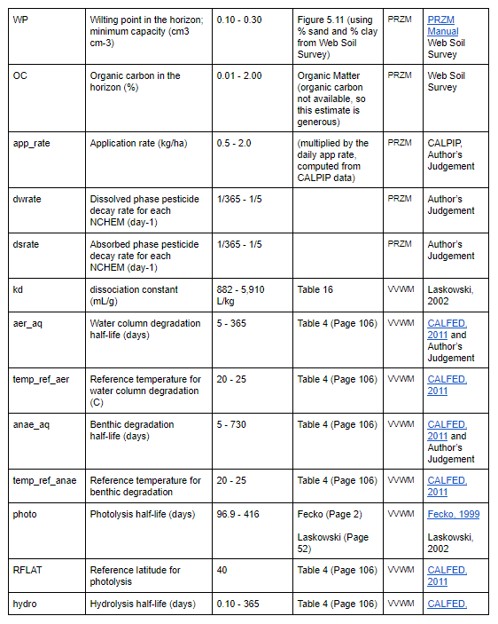
Probabilistic Input Ranges

Slide 23
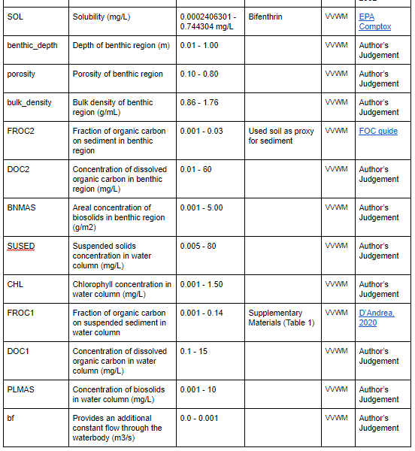
Probabilistic Input Ranges

Slide 24
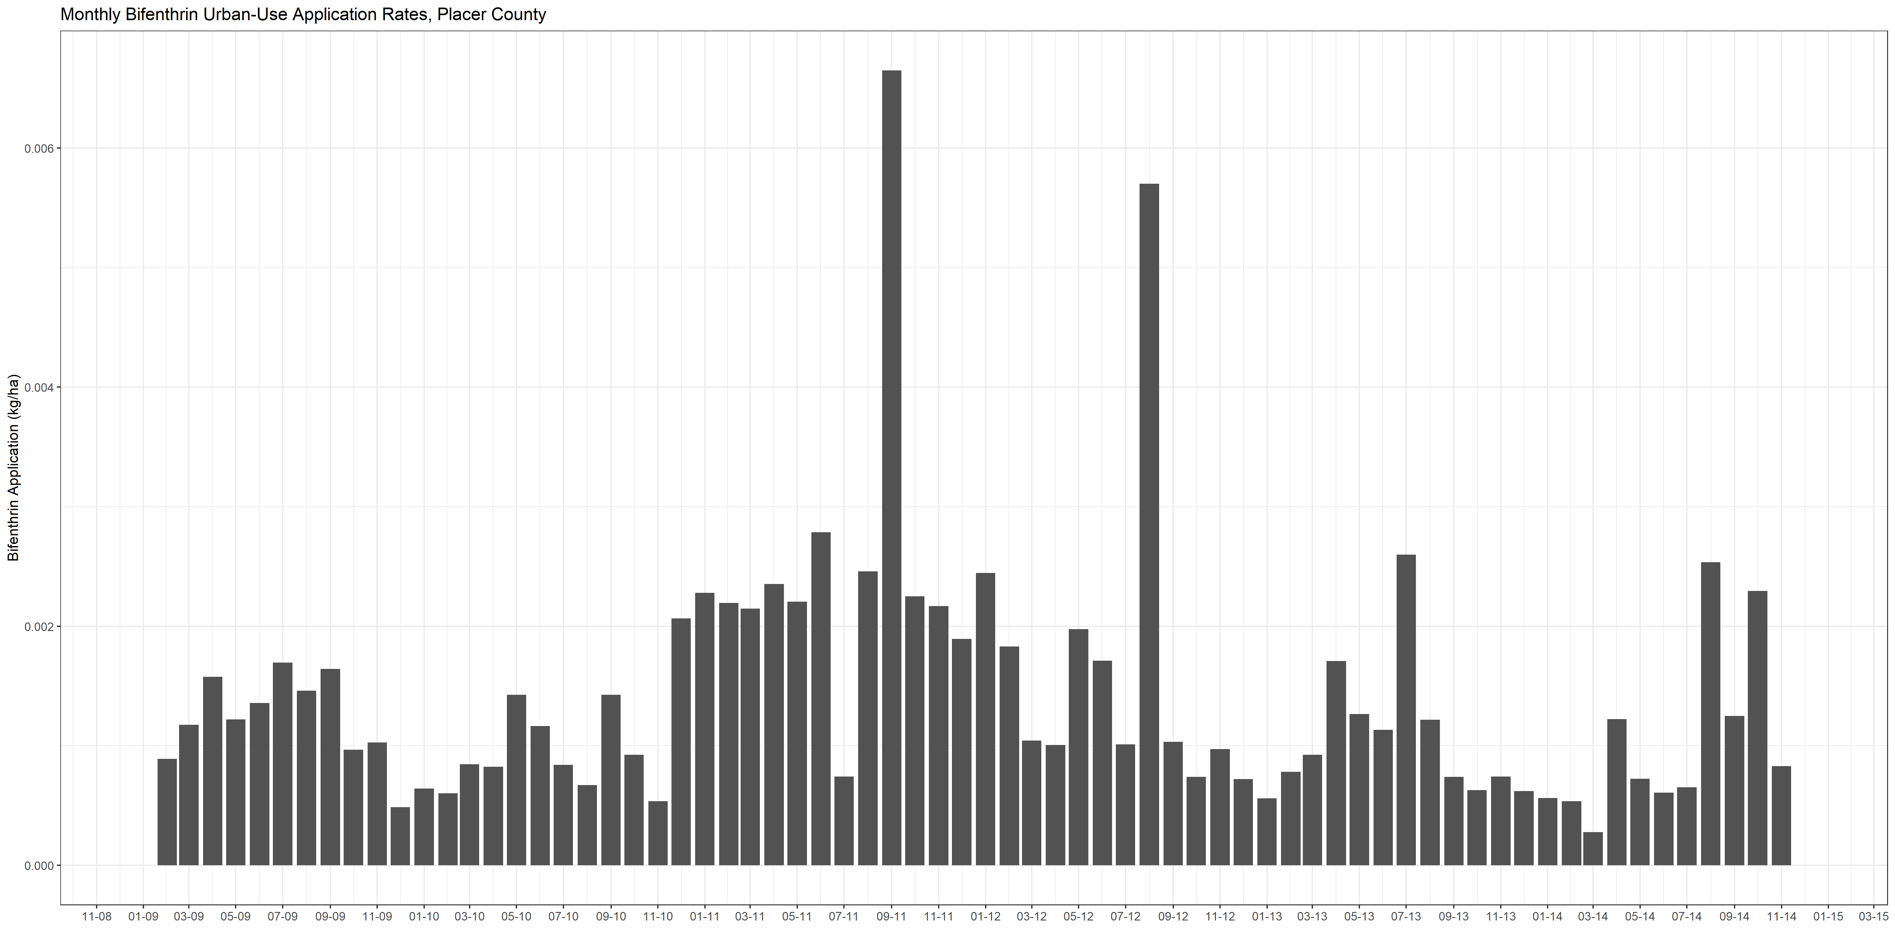
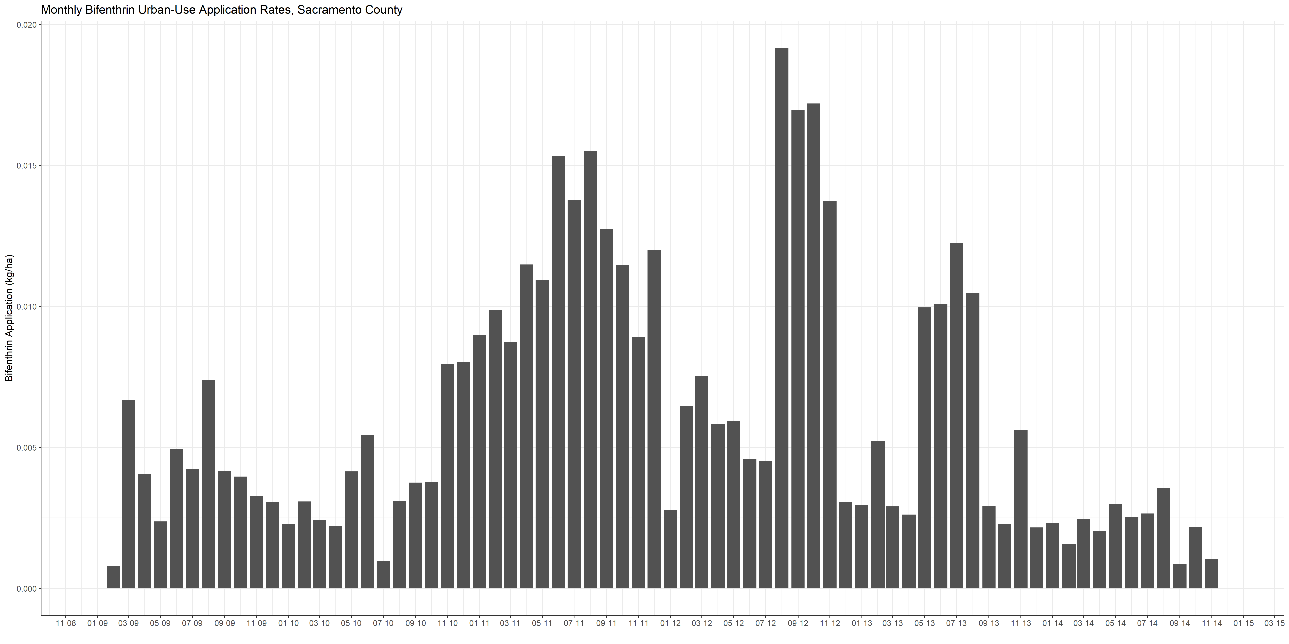
Application Rates

